Slide 1
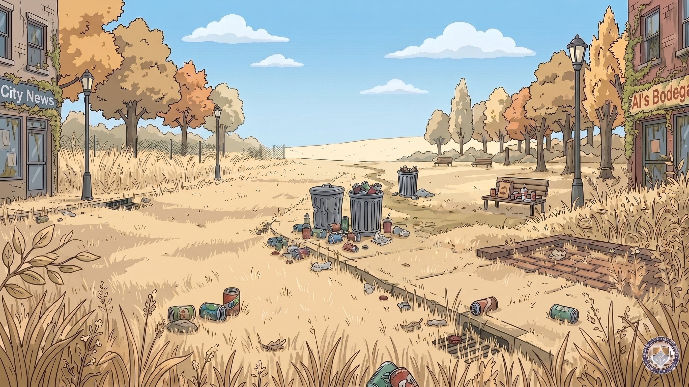
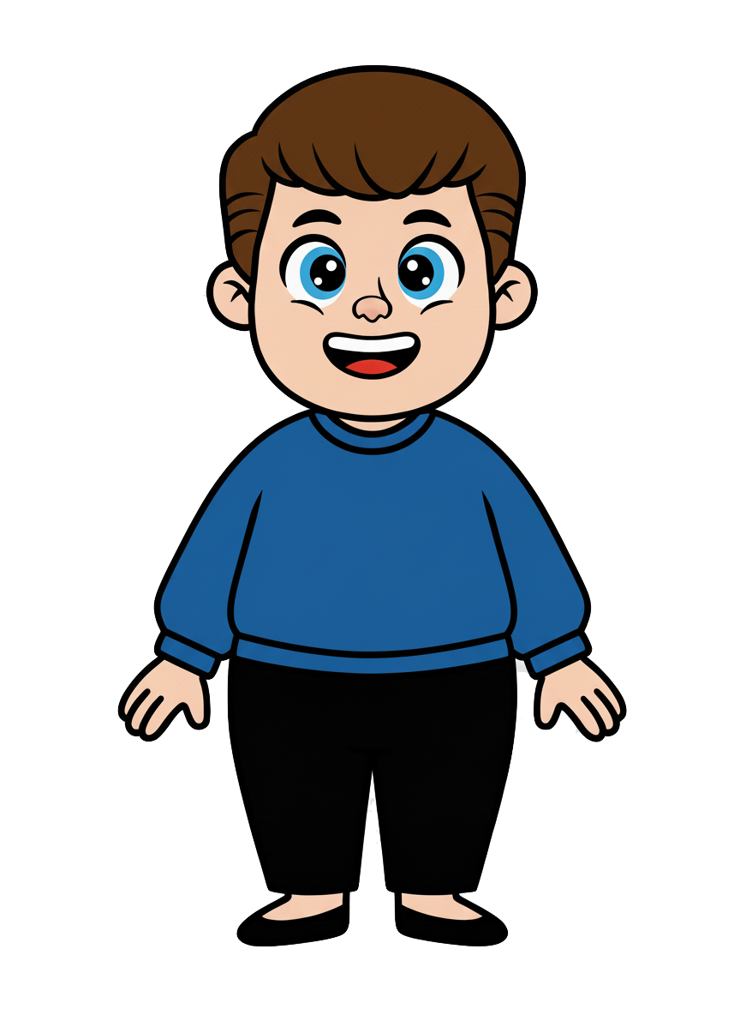
This is Kai

Slide 2
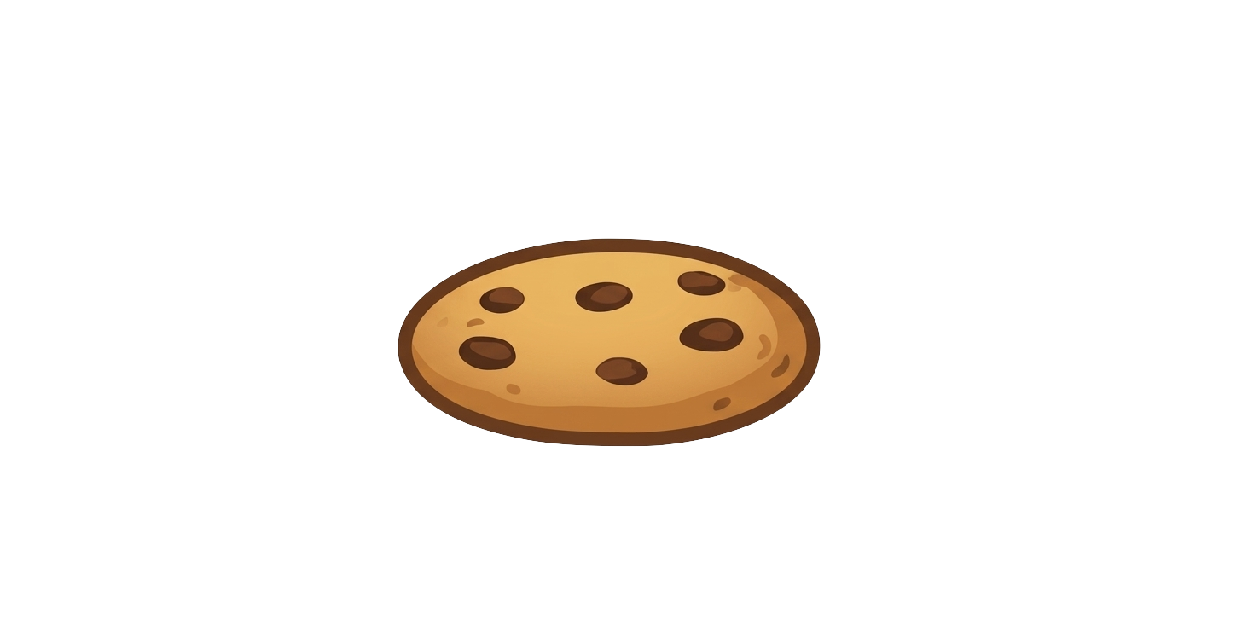
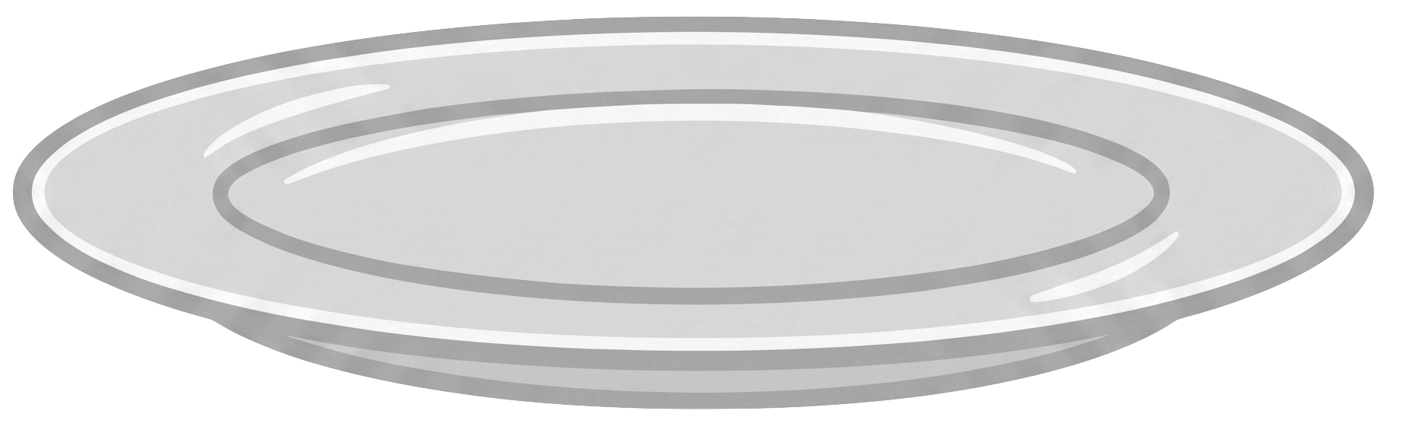
Kai has 5 cookies

Slide 3
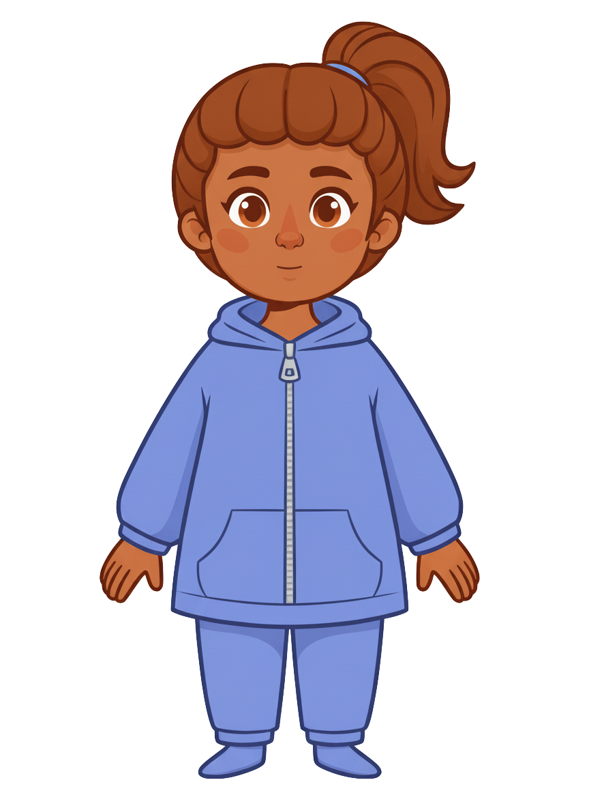
This is Ruby

Slide 4
Ruby has 3 cookies

Slide 5
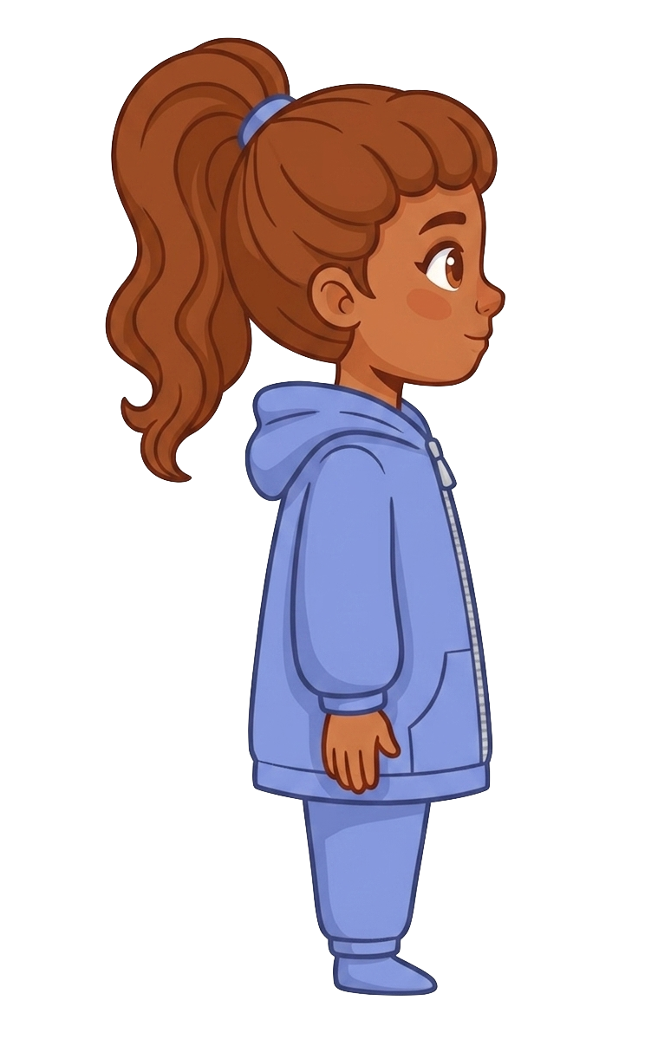
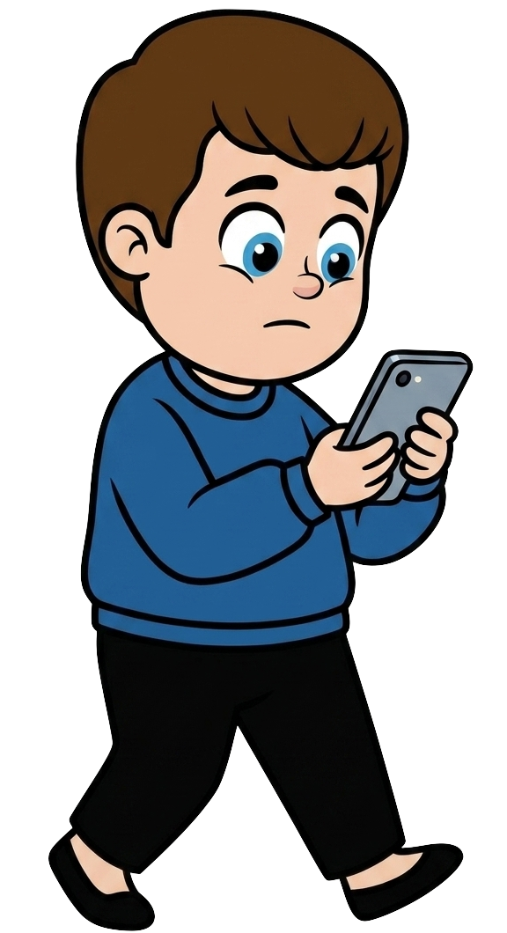
Kai walks without looking at the road

Slide 6
Kai walks without looking at the road

Slide 7
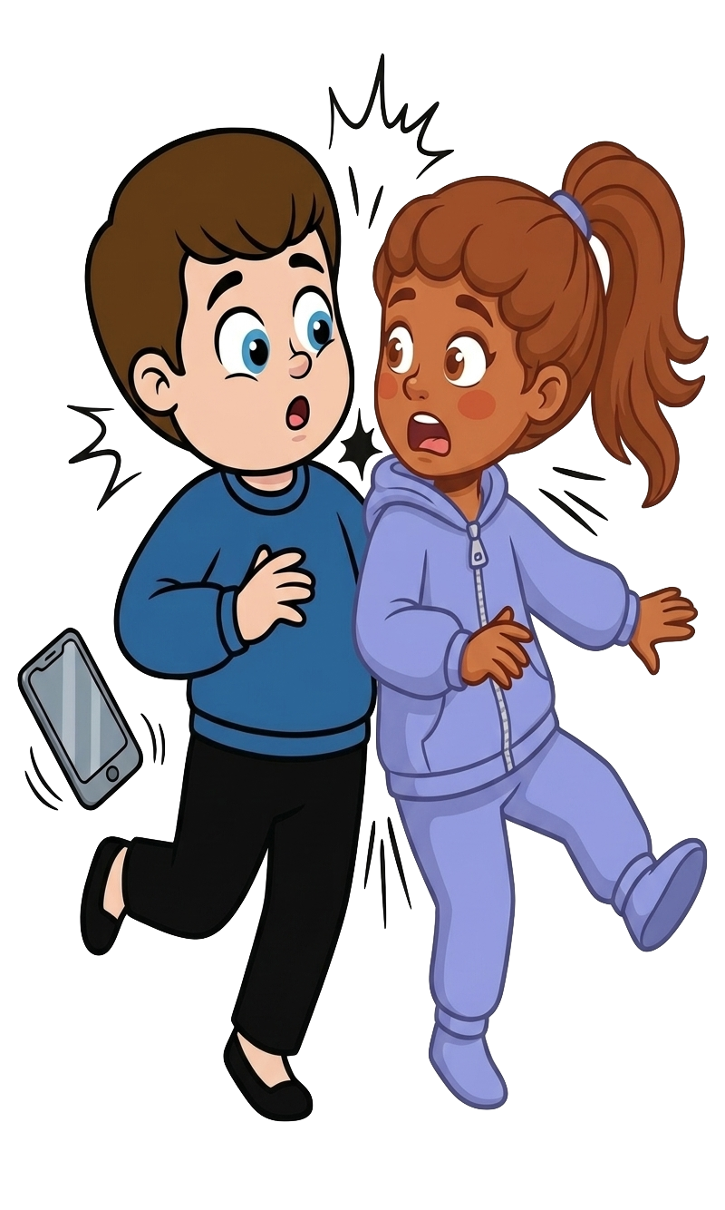
Oh no! Kai bumps into Ruby!

Slide 8
2 of Ruby’s cookies fell!

Slide 9
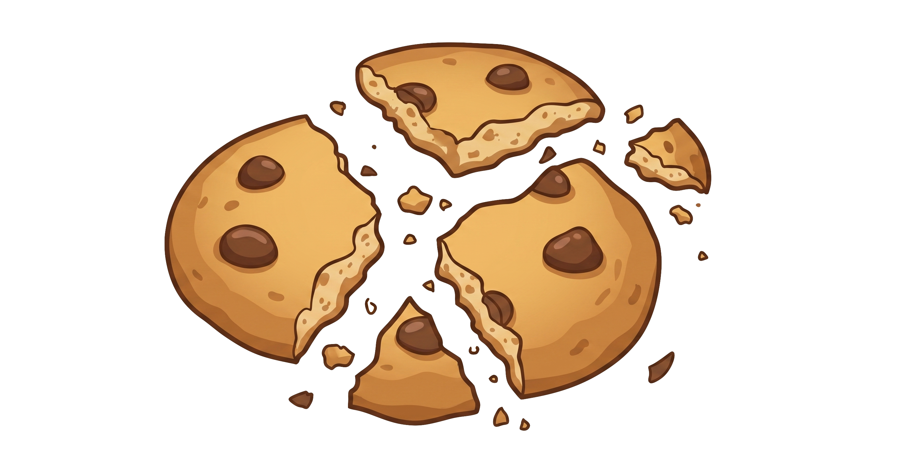
Kai still has 5 cookies. Ruby now has 1 cookie.

Slide 10
Please decide whether you would like to move some of Kai’s cookies.

